Slide 1
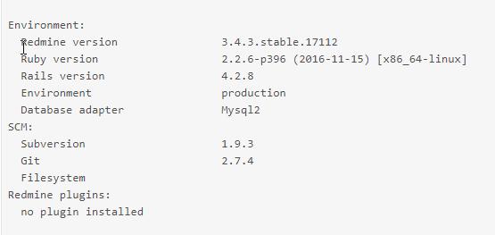
Project
Sub Project
Sub Project
Sub Project
Not this way
Project
Sub Project
Sub Project
Sub Project

