Slide 1
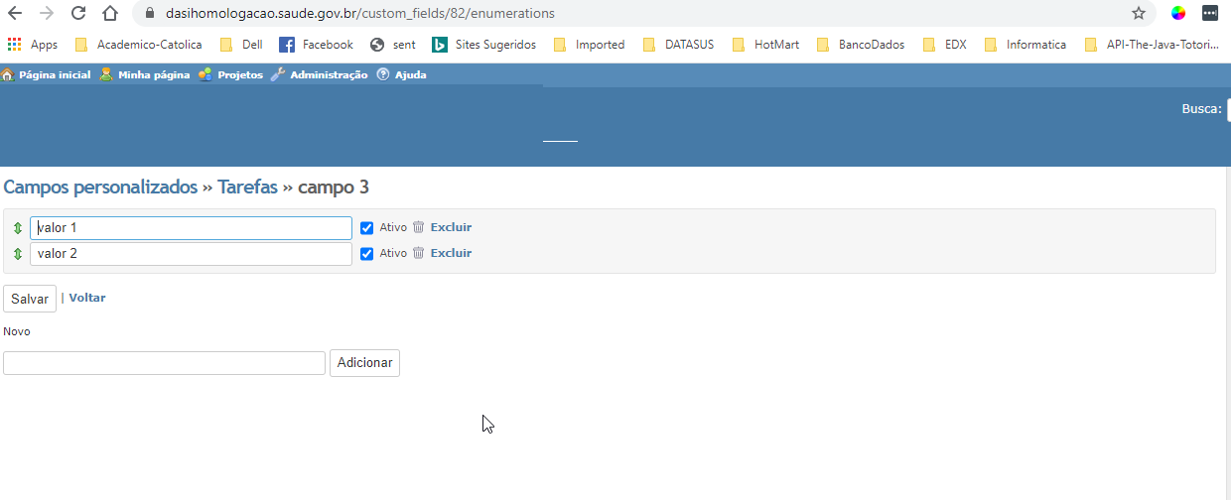


Implementation suggestion
Tarefa 1
Projeto 1
Tarefa 2
Projeto 2
285 / 5000
Good Morning ! If this implementation is carried out. Redmine reaches the highest level that exists in terms of dynamic publishing. Associate the active value of the items in the list with a specific task of a given project or subproject. This functionality is extremely important.
In this way I would have a list with attributes specific to a list for a given project. And other elements of the list suitable for another project associated with the tasks.

